Slide 1
Informatik 4
Lab 1

Slide 2
Laboratory Exercise Overview
Define size of 20 radius vectors
DCT transformation
Create Microsoft Excel spreadsheet
Create graphical representation for x(u)

Slide 3
DCT
A discrete cosine transform (DCT) expresses a sequence of finitely many data points in terms of a sum of cosine functions oscillating at different frequencies.
DCTs are important to numerous applications in science and engineering, from lossy compression of audio and images (where small high-frequency components can be discarded), to spectral methods for the numerical solution of partial differential equations.

Slide 4
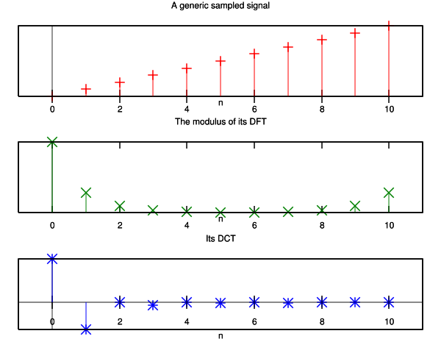
DCT
In particular, a DCT is a Fourier-related transform similar to the discrete Fourier transform (DFT), but using only real numbers.

Slide 5
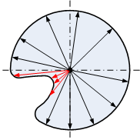
Radius Vectors
(x_{c},y_{c})

Slide 6
DCT
N – total number of coefficients
u – frequency spectrum index

Slide 7
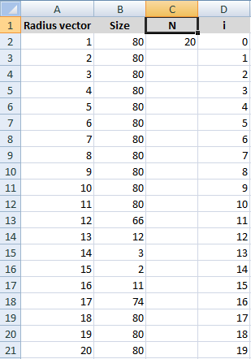
Excel Step 1

Slide 8
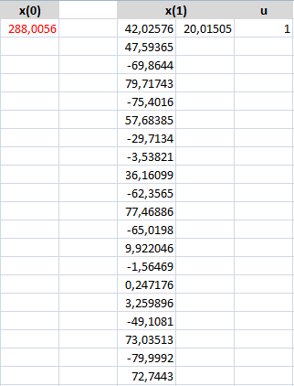
Excel Step 2
X(0) =(1/SQRT(C2))*SUM(B2:B21)
X(1) =B2*COS(((2*$D2+1)*$L$24*180)/(2*$C$2))
pi=180

Slide 9
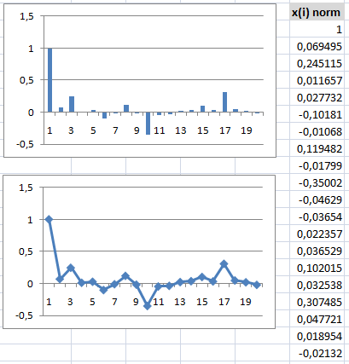
Excel Step 3
X(i)norm =F2/$F$2

Slide 10
Final Graphs

Slide 11
Conclusion
DCT parametrical featured description is not rotation and translation invariant.
DCT parametrical featured description is scale invariant after applying normalization.

